Slide 1
Classification:
Decision Trees
Notes:
Lecture 1

Slide 2
Outline
Top-Down Decision Tree Construction
Choosing the Splitting Attribute
Information Gain and Gain Ratio

Slide 3
DECISION TREE
An internal node is a test on an attribute.
A branch represents an outcome of the test, e.g., Color=red.
A leaf node represents a class label or class label distribution.
At each node, one attribute is chosen to split training examples into distinct classes as much as possible
A new case is classified by following a matching path to a leaf node.

Slide 4
Weather Data: Play or not Play?
Outlook | Temperature | Humidity | Windy | Play?
sunny | hot | high | false | No
sunny | hot | high | true | No
overcast | hot | high | false | Yes
rain | mild | high | false | Yes
rain | cool | normal | false | Yes
rain | cool | normal | true | No
overcast | cool | normal | true | Yes
sunny | mild | high | false | No
sunny | cool | normal | false | Yes
rain | mild | normal | false | Yes
sunny | mild | normal | true | Yes
overcast | mild | high | true | Yes
overcast | hot | normal | false | Yes
rain | mild | high | true | No
Note:
Outlook is the
Forecast,
no relation to
Microsoft
email program

Slide 5
Example Tree for “Play?”
Outlook
sunny
overcast
rain
Humidity
Yes
Windy
high
normal
true
false
No
Yes
No
Yes

Slide 6
Building Decision Tree [Q93]
Top-down tree construction
  At start, all training examples are at the root.
  Partition the examples recursively by choosing one attribute each time.
Bottom-up tree pruning
  Remove subtrees or branches, in a bottom-up manner, to improve the estimated accuracy on new cases.

Slide 7
Choosing the Splitting Attribute
At each node, available attributes are evaluated on the basis of separating the classes of the training examples. A Goodness function is used for this purpose.
Typical goodness functions:
  information gain (ID3/C4.5)
  information gain ratio
  gini index
witten&eibe

Slide 8
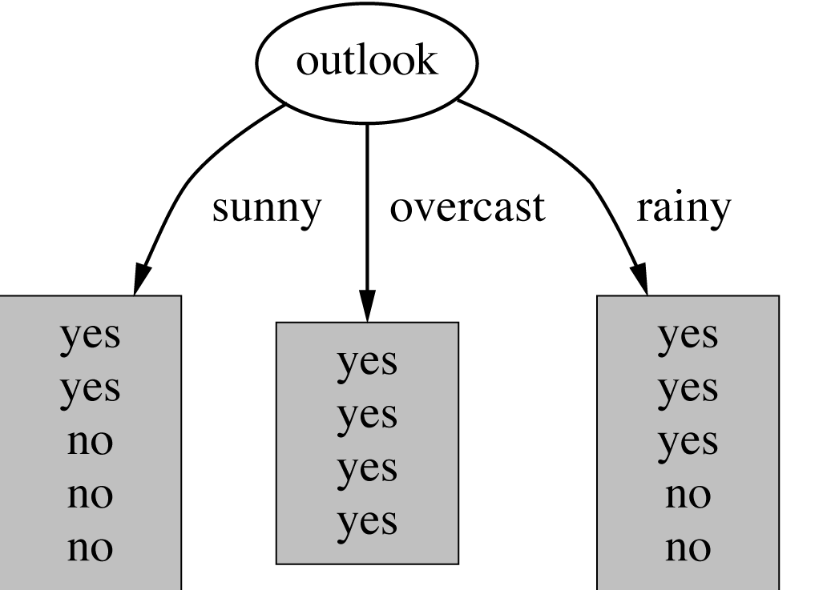
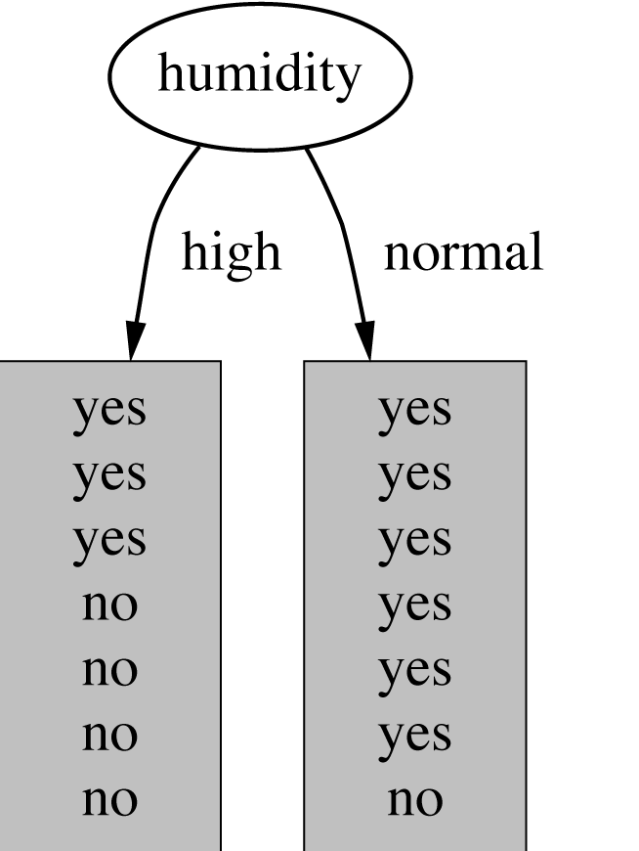
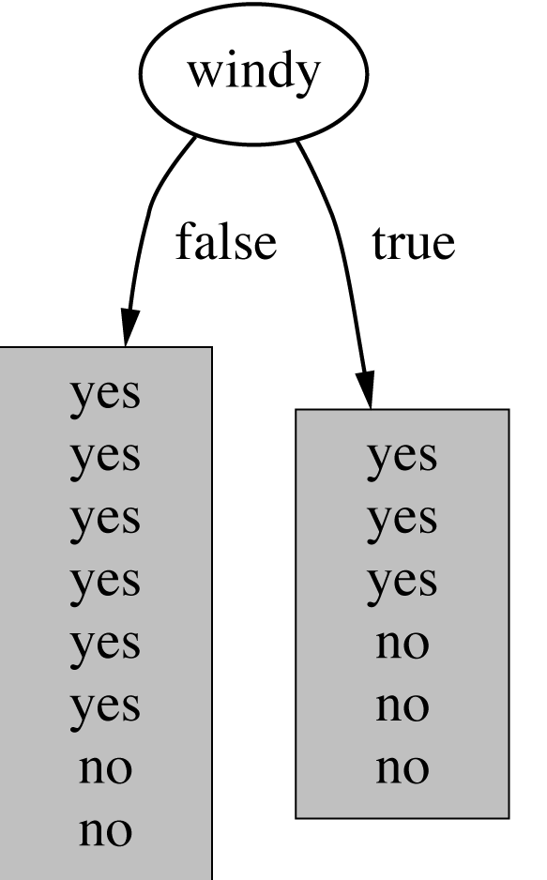
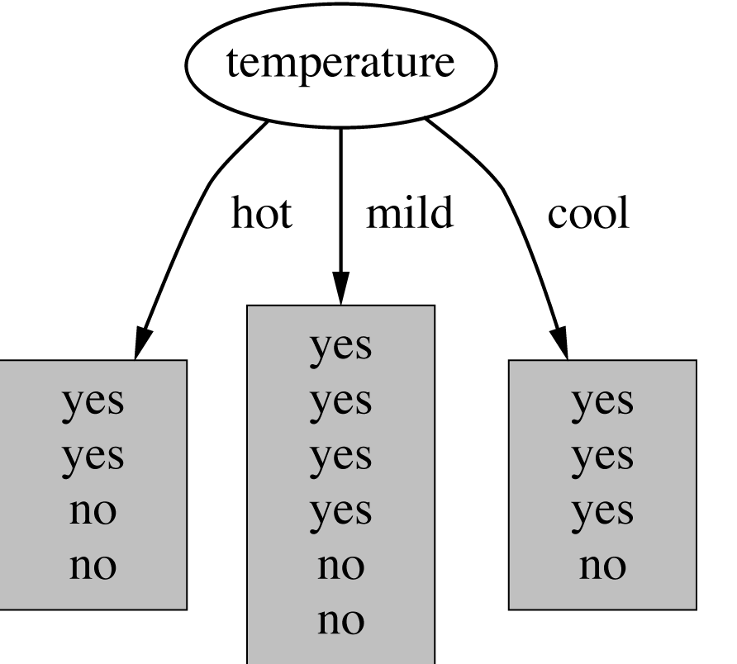
Which attribute to select?
witten&eibe

Slide 9
A criterion for attribute selection
Which is the best attribute?
  The one which will result in the smallest tree
  Heuristic: choose the attribute that produces the “purest” nodes
Popular impurity criterion: information gain
  Information gain increases with the average purity of the subsets that an attribute produces
Strategy: choose attribute that results in greatest information gain
witten&eibe

Slide 10
Computing information
Information is measured in bits
  Given a probability distribution, the info required to predict an event is the distribution’s entropy
  Entropy gives the information required in bits (this can involve fractions of bits!)
Formula for computing the entropy:
witten&eibe

Slide 11
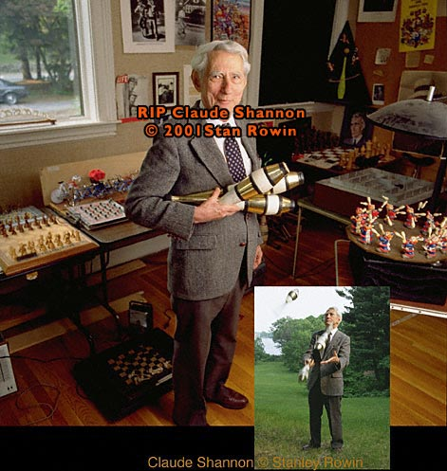
*Claude Shannon
“Father of information theory”
Born: 30 April 1916
Died: 23 February 2001
Claude Shannon, who has died aged 84, perhaps more than anyone laid the groundwork for today’s digital revolution. His exposition of information theory, stating that all information could be represented mathematically as a succession of noughts and ones, facilitated the digital manipulation of data without which today’s information society would be unthinkable.
Shannon’s master’s thesis, obtained in 1940 at MIT, demonstrated that problem solving could be achieved by manipulating the symbols 0 and 1 in a process that could be carried out automatically with electrical circuitry. That dissertation has been hailed as one of the most significant master’s theses of the 20th century. Eight years later, Shannon published another landmark paper, A Mathematical Theory of Communication, generally taken as his most important scientific contribution.
Shannon applied the same radical approach to cryptography research, in which he later became a consultant to the US government.
Many of Shannon’s pioneering insights were developed before they could be applied in practical form. He was truly a remarkable man, yet unknown to most of the world.
witten&eibe

Slide 12

Example: attribute “Outlook”
“Outlook” = “Sunny”:
“Outlook” = “Overcast”:
“Outlook” = “Rainy”:
Expected information for attribute:
Note: log(0) is not defined, but we evaluate 0*log(0) as zero
witten&eibe

Slide 13


Computing the information gain
Information gain:
(information before split) – (information after split)
Information gain for attributes from weather data:
witten&eibe

Slide 14
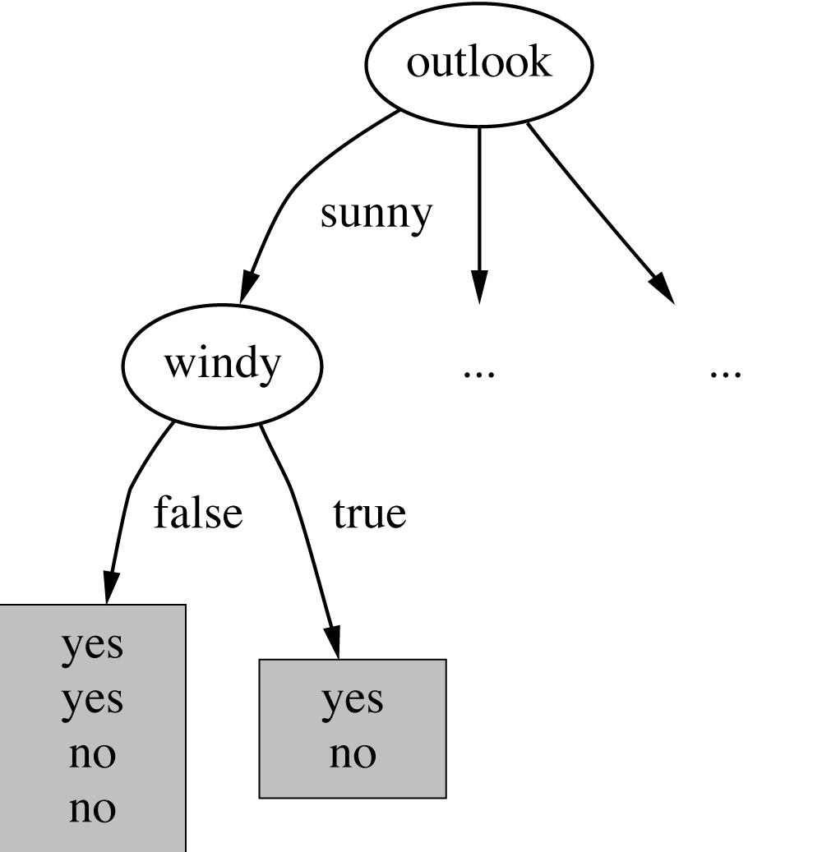
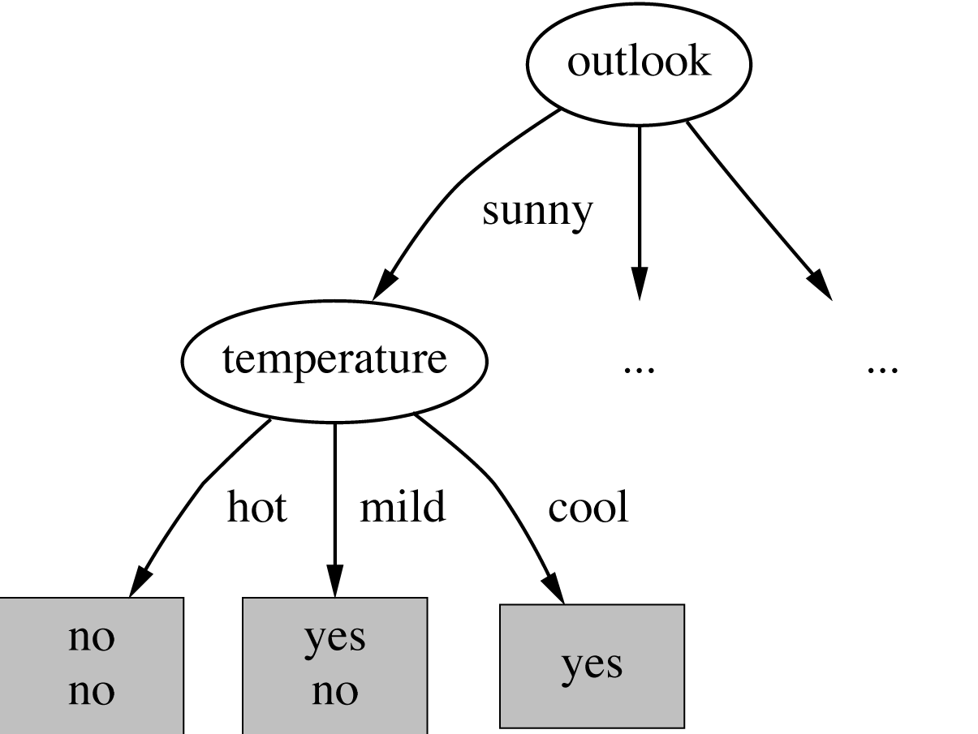
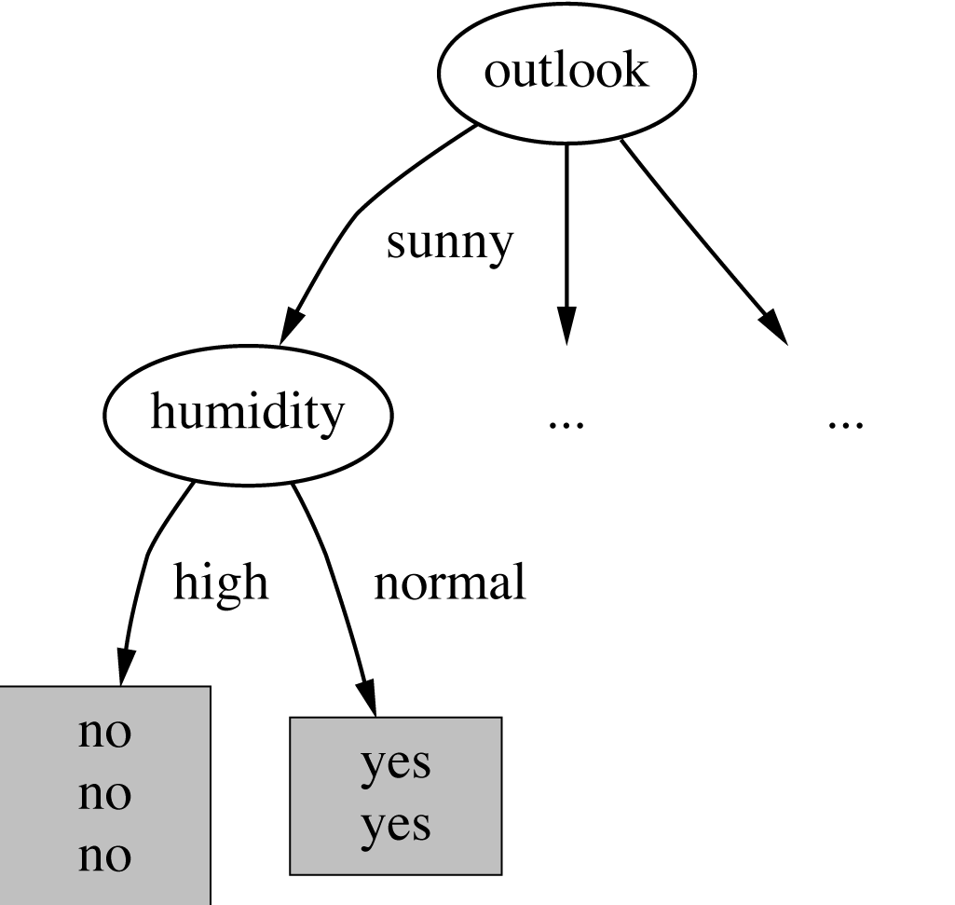

Continuing to split
witten&eibe

Slide 15
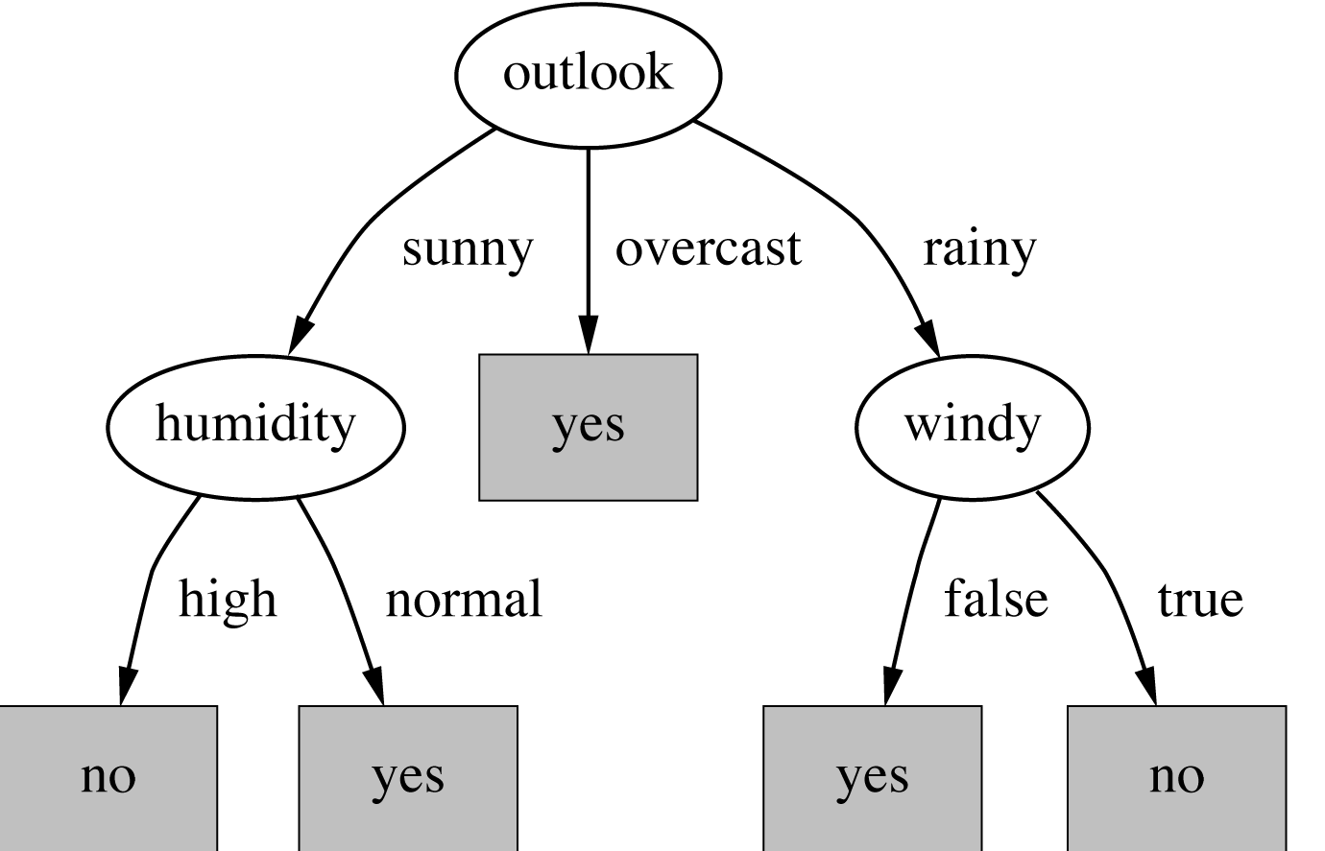
The final decision tree
Note: not all leaves need to be pure; sometimes identical instances have different classes
  ⇒ Splitting stops when data can’t be split any further
witten&eibe

Slide 16
*Wish list for a purity measure
Properties we require from a purity measure:
  When node is pure, measure should be zero
  When impurity is maximal (i.e. all classes equally likely), measure should be maximal
  Measure should obey multistage property (i.e. decisions can be made in several stages):
Entropy is a function that satisfies all three properties!
witten&eibe

Slide 17
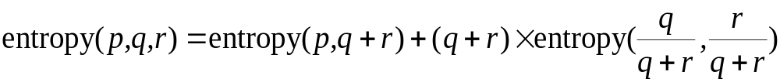
*Properties of the entropy
The multistage property:
Simplification of computation:
Note: instead of maximizing info gain we could just minimize information
witten&eibe

Slide 18
Highly-branching attributes
Problematic: attributes with a large number of values (extreme case: ID code)
Subsets are more likely to be pure if there is a large number of values
  Information gain is biased towards choosing attributes with a large number of values
  This may result in overfitting (selection of an attribute that is non-optimal for prediction)
witten&eibe

Slide 19
Weather Data with ID code
ID | Outlook | Temperature | Humidity | Windy | Play?
A | sunny | hot | high | false | No
B | sunny | hot | high | true | No
C | overcast | hot | high | false | Yes
D | rain | mild | high | false | Yes
E | rain | cool | normal | false | Yes
F | rain | cool | normal | true | No
G | overcast | cool | normal | true | Yes
H | sunny | mild | high | false | No
I | sunny | cool | normal | false | Yes
J | rain | mild | normal | false | Yes
K | sunny | mild | normal | true | Yes
L | overcast | mild | high | true | Yes
M | overcast | hot | normal | false | Yes
N | rain | mild | high | true | No

Slide 20
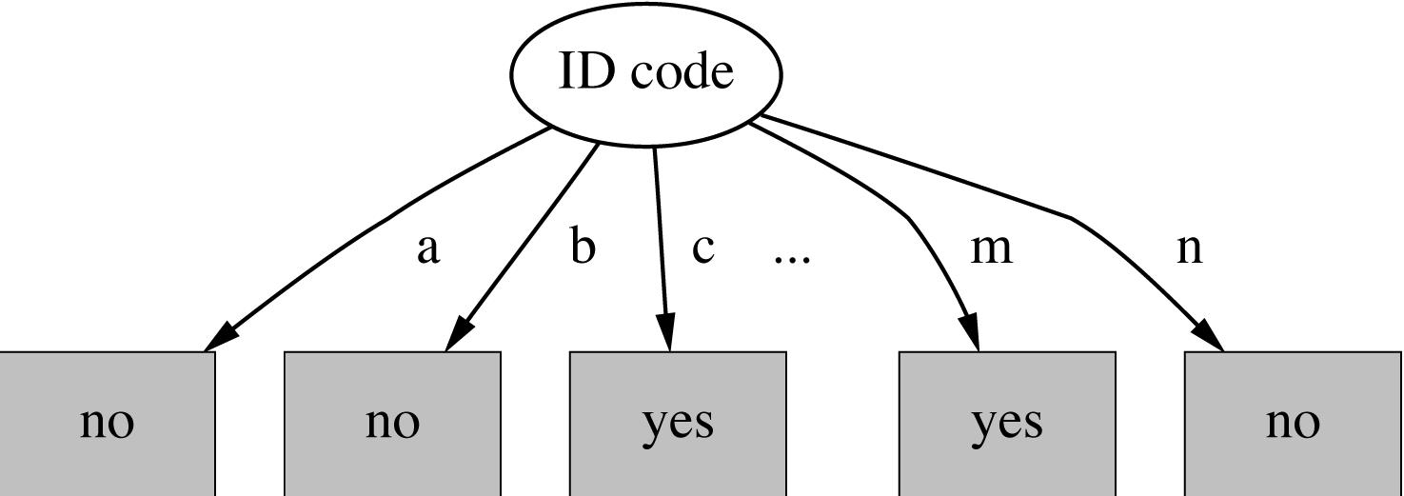
Split for ID Code Attribute
Entropy of split = 0 (since each leaf node is “pure”, having only
one case.
Information gain is maximal for ID code
witten&eibe

Slide 21
Gain ratio
Gain ratio: a modification of the information gain that reduces its bias on high-branch attributes
Gain ratio should be
  Large when data is evenly spread
  Small when all data belong to one branch
Gain ratio takes number and size of branches into account when choosing an attribute
  It corrects the information gain by taking the intrinsic information of a split into account (i.e. how much info do we need to tell which branch an instance belongs to)
witten&eibe

Slide 22
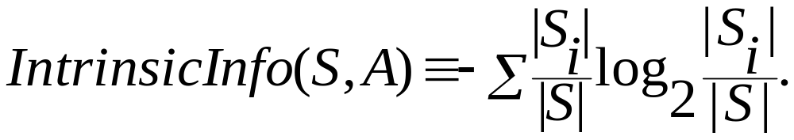
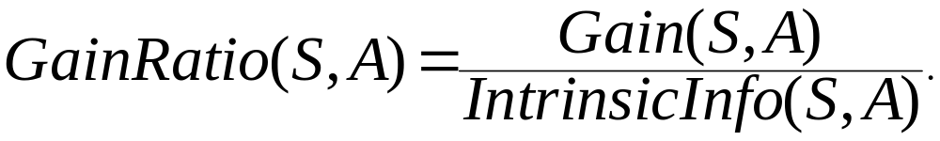
Gain Ratio and Intrinsic Info.
Intrinsic information: entropy of distribution of instances into branches
Gain ratio (Quinlan’86) normalizes info gain by:

Slide 23
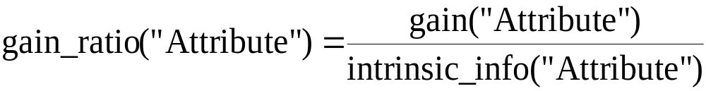
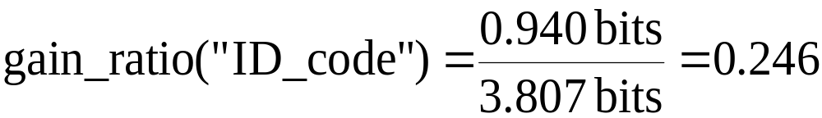
Computing the gain ratio
Example: intrinsic information for ID code
Importance of attribute decreases as intrinsic information gets larger
Example of gain ratio:
Example:
witten&eibe

Slide 24
Gain ratios for weather data
Outlook |  | Temperature
Info: | 0.693 | Info: | 0.911
Gain: 0.940-0.693 | 0.247 | Gain: 0.940-0.911 | 0.029
Split info: info([5,4,5]) | 1.577 | Split info: info([4,6,4]) | 1.362
Gain ratio: 0.247/1.577 | 0.156 | Gain ratio: 0.029/1.362 | 0.021
Humidity |  | Windy
Info: | 0.788 | Info: | 0.892
Gain: 0.940-0.788 | 0.152 | Gain: 0.940-0.892 | 0.048
Split info: info([7,7]) | 1.000 | Split info: info([8,6]) | 0.985
Gain ratio: 0.152/1 | 0.152 | Gain ratio: 0.048/0.985 | 0.049
witten&eibe

Slide 25
More on the gain ratio
“Outlook” still comes out top
However: “ID code” has greater gain ratio
  Standard fix: ad hoc test to prevent splitting on that type of attribute
Problem with gain ratio: it may overcompensate
  May choose an attribute just because its intrinsic information is very low
  Standard fix:
    First, only consider attributes with greater than average information gain
    Then, compare them on gain ratio
witten&eibe

Slide 26
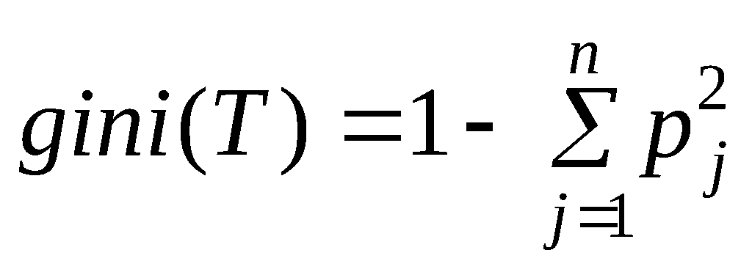
*CART Splitting Criteria: Gini Index
If a data set T contains examples from n classes, gini index, gini(T) is defined as
where p_{j} is the relative frequency of class j in T.
gini(T) is minimized if the classes in T are skewed.

Slide 27
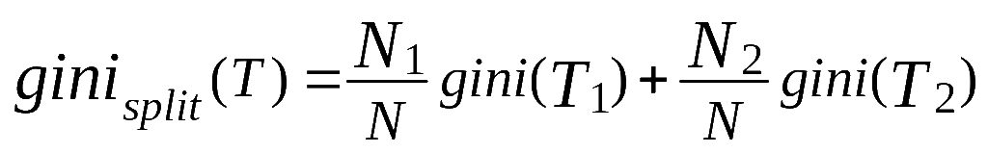
*Gini Index
After splitting T into two subsets T1 and T2 with sizes N1 and N2, the gini index of the split data is defined as
The attribute providing smallest gini_{split}(T) is chosen to split the node.

Slide 28
Discussion
Algorithm for top-down induction of decision trees (“ID3”) was developed by Ross Quinlan
  Gain ratio just one modification of this basic algorithm
  Led to development of C4.5, which can deal with numeric attributes, missing values, and noisy data
There are many other attribute selection criteria! (But almost no difference in accuracy of result.)

Slide 29
Summary
Top-Down Decision Tree Construction
Choosing the Splitting Attribute
Information Gain biased towards attributes with a large number of values
Gain Ratio takes number and size of branches into account when choosing an attribute

